Slide 1
Avocado Predictions
Machine Learning
Price and Image Predictions
By: Brian Connell, Joe Morici, Ashok Bidani, Sandra Langston

Slide 2
Avocado Predictions
1.) Price Forecaster
2.) Image classifier (”Ripe Avocado" / "Not Ripe Avocado“)
3.) Flask WEB app

Slide 3
Avocado Facts
Data is taken from the Hass Avocado Board
Dataset is specifically the prices, volume, and so on of Hass avocados sold in the U.S.
The Hass avocado variety amounts to 95% of avocados sold in the U.S.
93% of avocados sold in the U.S. come from Mexico, Hass and otherwise

Slide 4
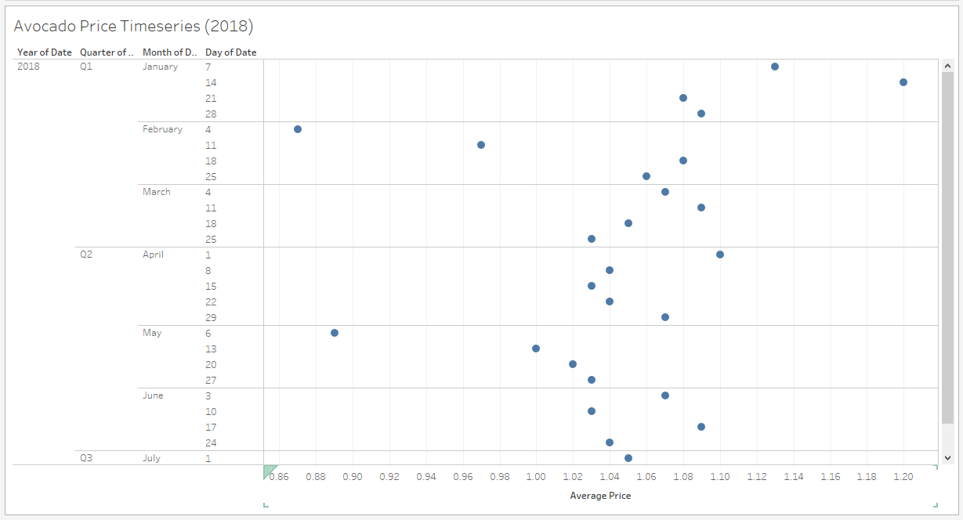
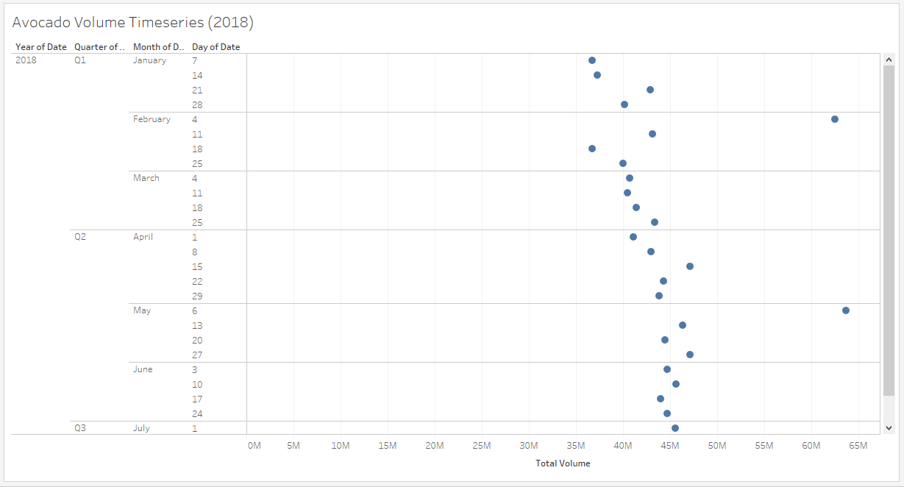
Avocado Data Analysis
Seasonal variation in price and output from January through June. The volume of avocados sold steadily increases into the hot season and the price steadily decreases accordingly
There are two interesting points on the first weeks of February and May. Not sure what the explanation for this is, perhaps there is a major shipment or purchase by supermarkets or restaurant chains in the industry at this time

Slide 5
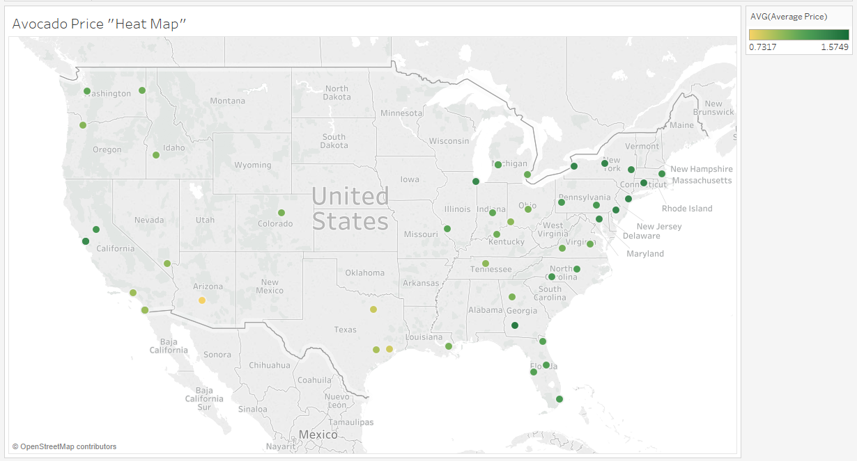
Price Map

Slide 6
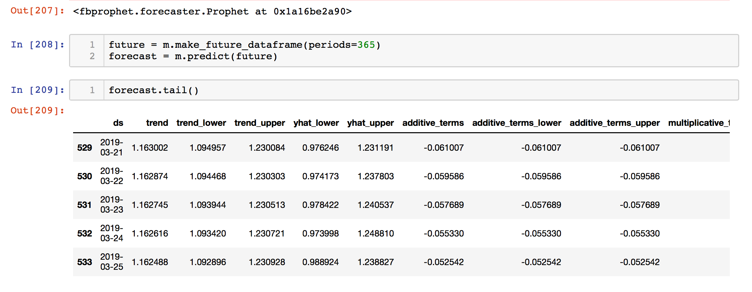
Price Forecasting Price forecasting using Facebook's "Prophet" created by Facebook's in house data scientists. Prophet is a procedure for forecasting time series data based on an additive model where non-linear trends are fit with yearly, weekly, and daily seasonality, plus holiday effects. It works best with time series that have strong seasonal effects and several seasons of historical data. Prophet is robust to missing data and shifts in the trend, and typically handles outliers well. Data: 9127 dates and prices for time series

Slide 7
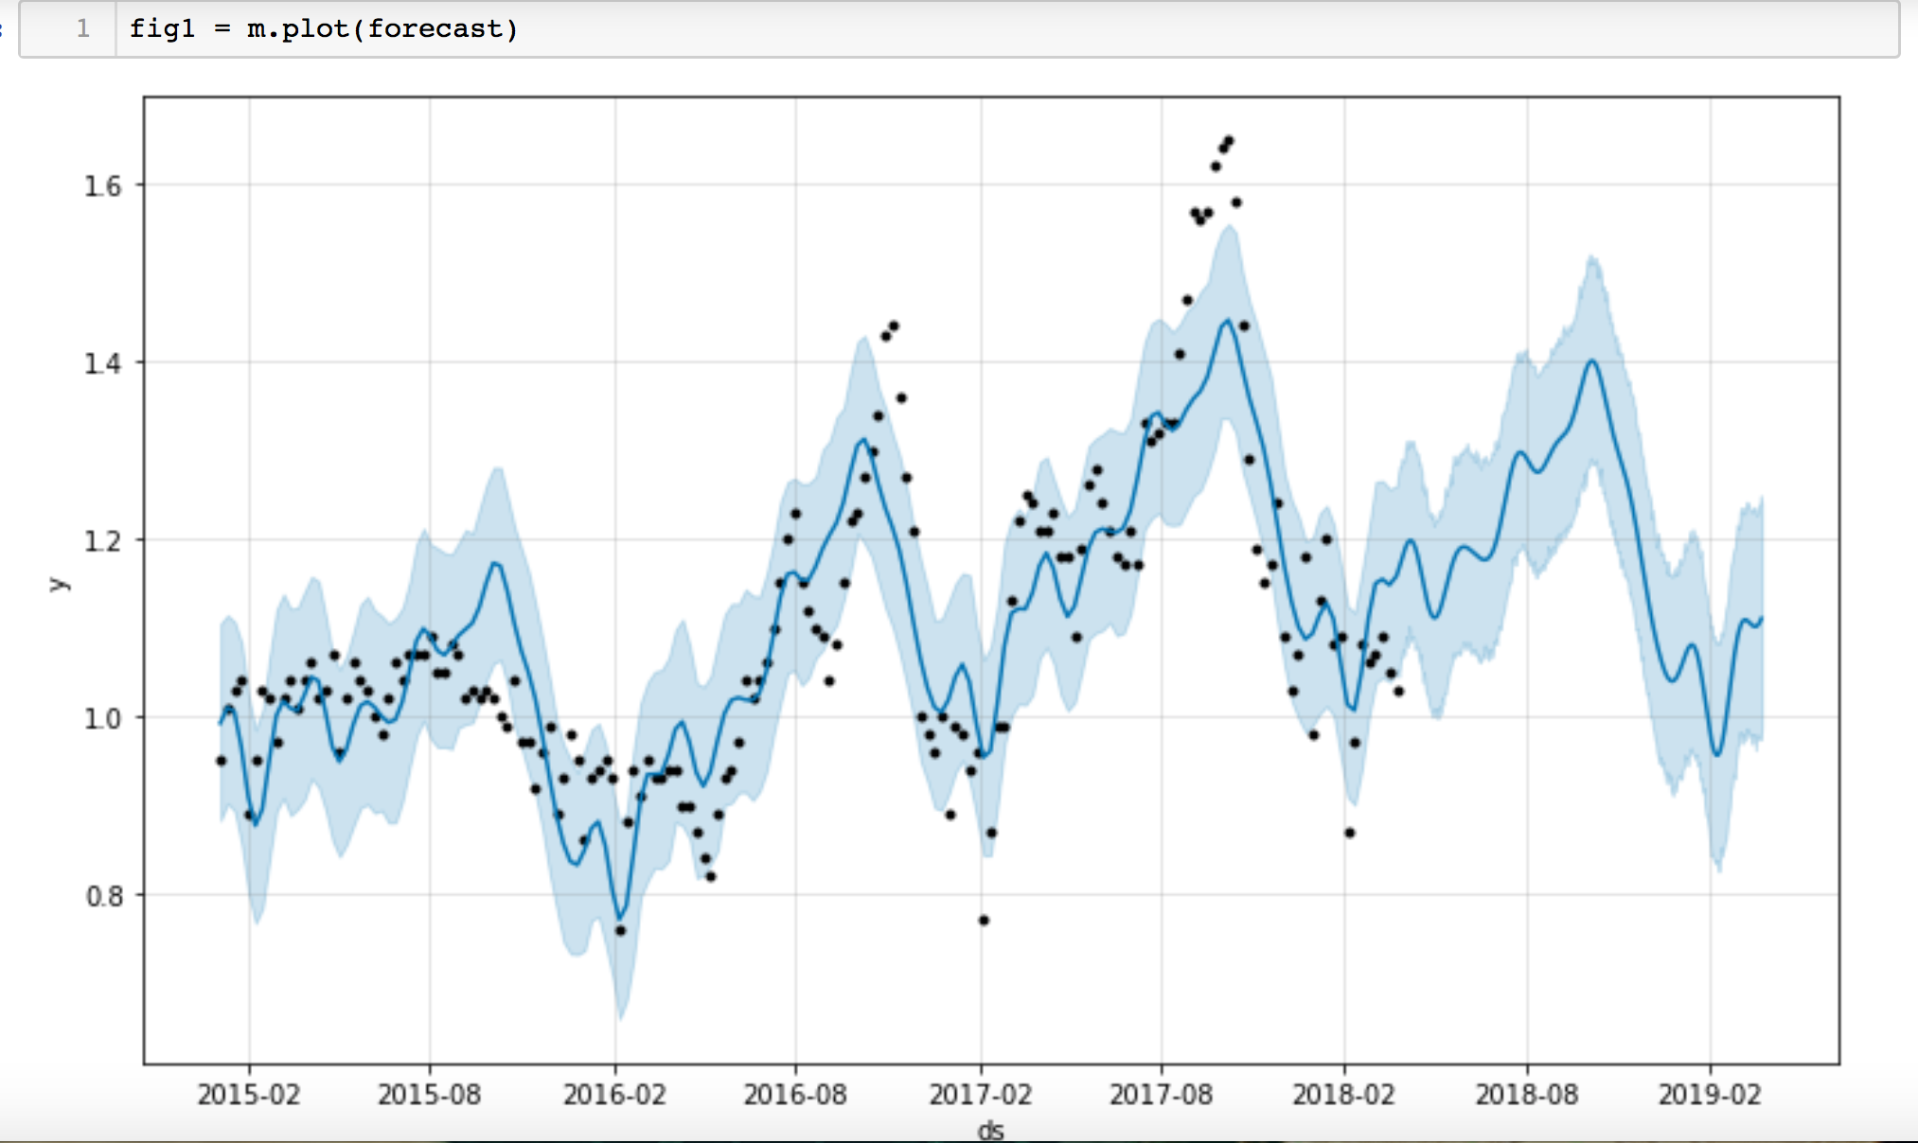
Outcome:

Slide 8
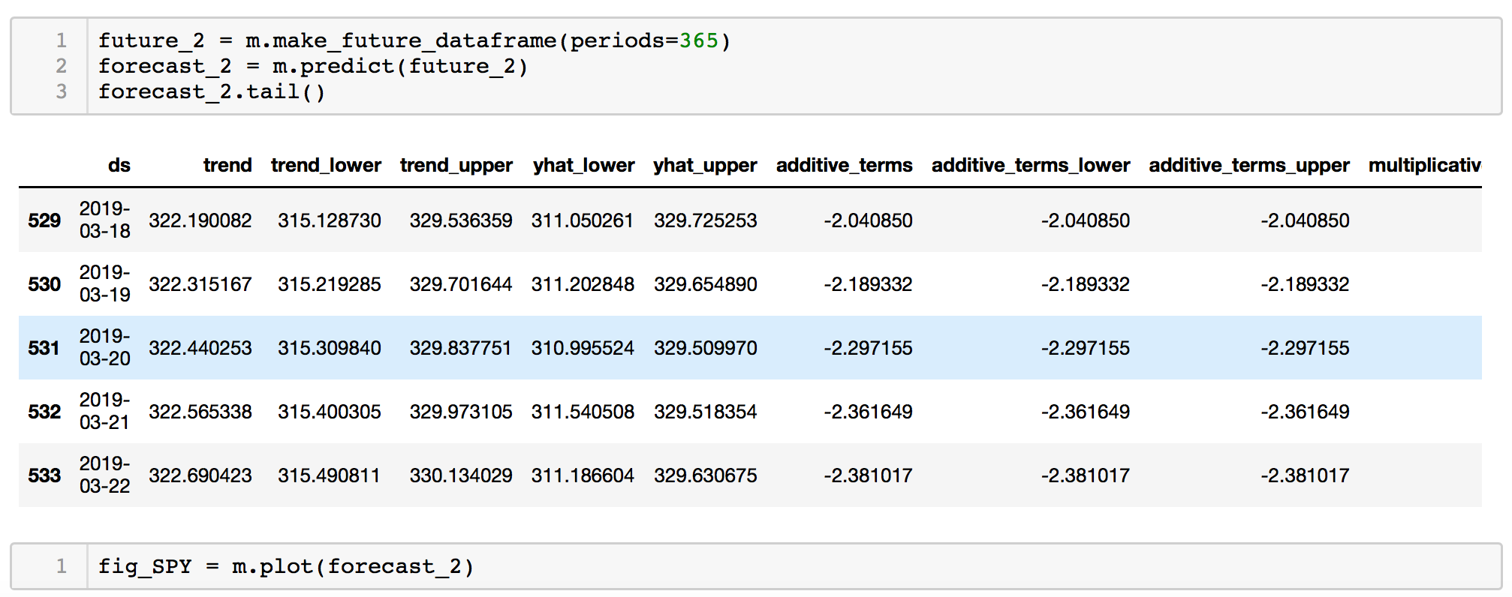
Interesting… but can it predict stock prices???
* Daily close day from the S&P 500 Index (SPY ETF). Roughly during the same time period of our Avocado data.

Slide 9
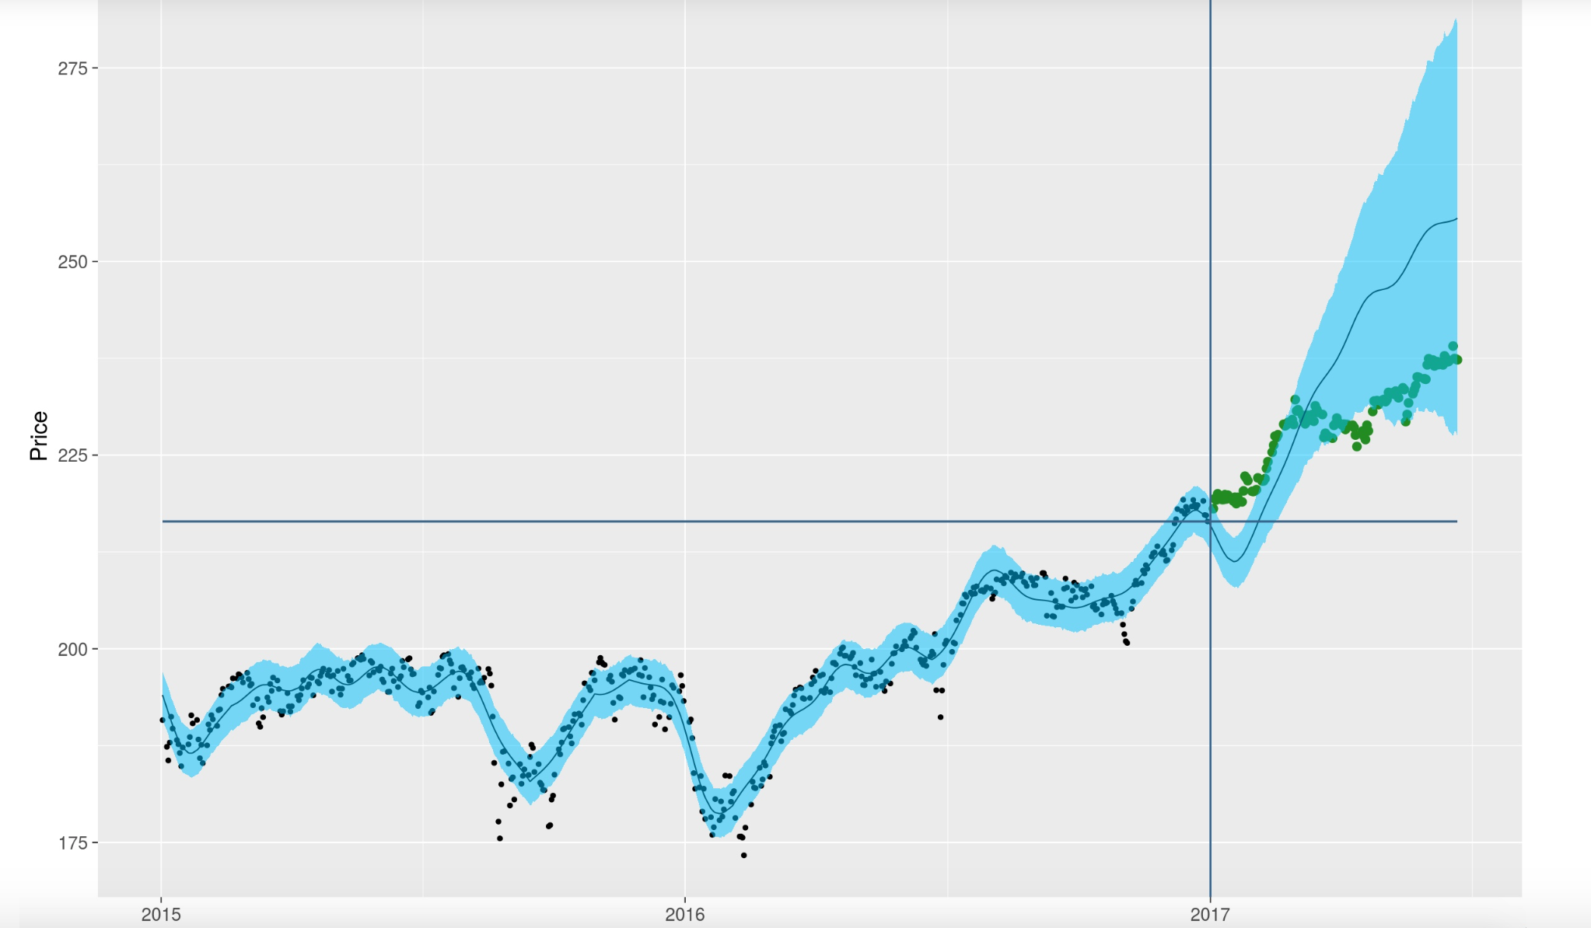
Outcome!?!? Kinda….

Slide 10
Convolutional Neural Network
Supervised Machine Learning
Built a Convolutional Neural Network and trained it on images of avocados so that the Neural Network can predict whether the image of an avocado is ripe or not.
The model can be trained on any type of class.

Slide 11
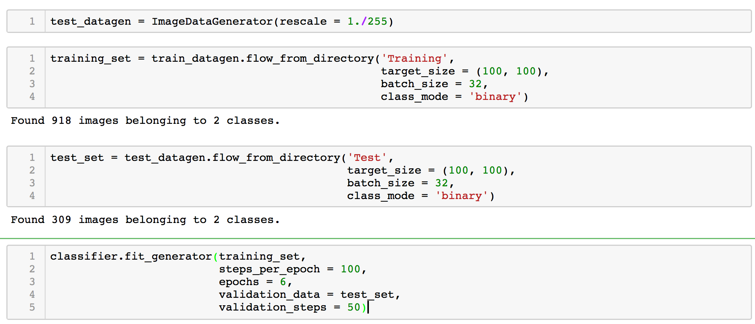
Ok, now lets try our CNNs using a variation of multilayer perceptron's designed to require minimal preprocessing. Dataset details:
918 images for training
309 images for testing

Slide 12
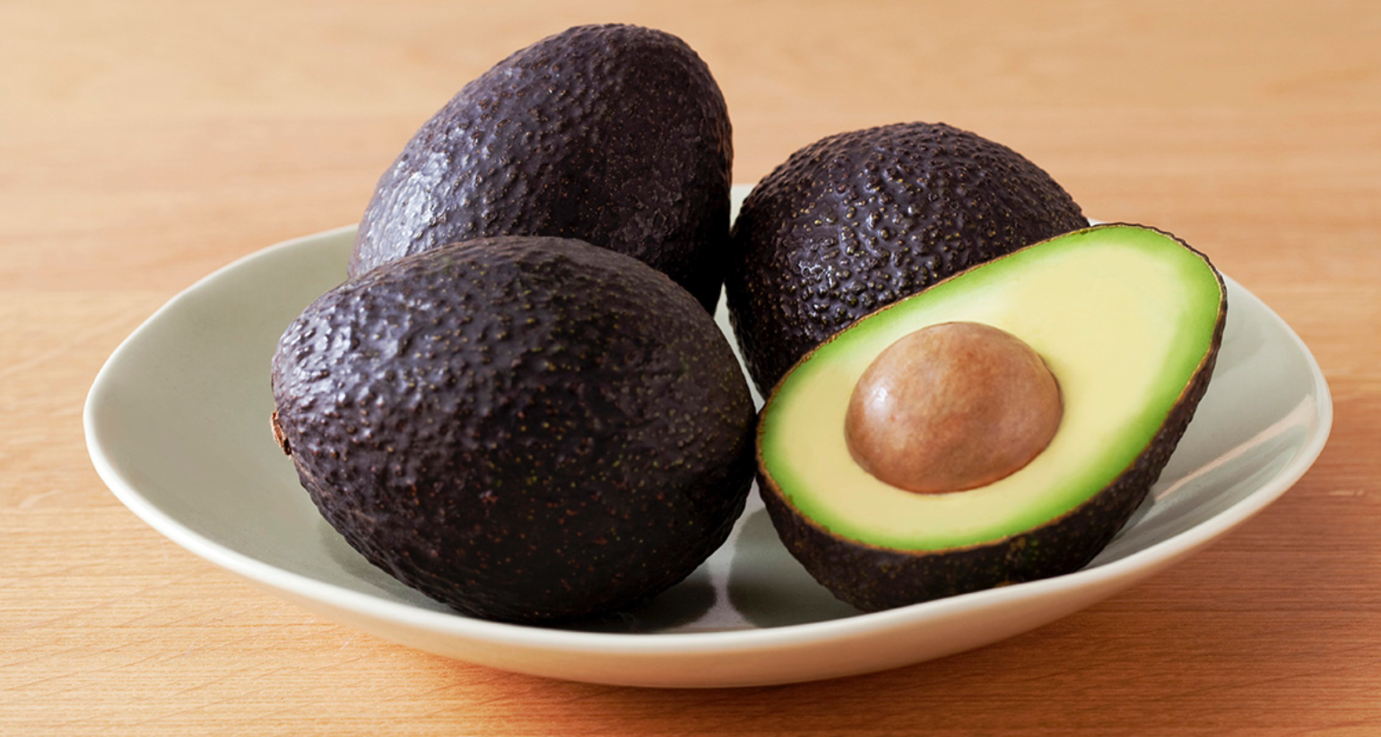
Outcome? Lets give it a try… PythonFlask Web App:
Ripe or Not?

Slide 13
Lessons Learned
Make sure you have enough CPU for your machine learning project.

Slide 14
Questions???

